Slide 1
Early Years Initial Teacher Training (EYITT)
Childminder offer 2026
Notes:
Welcome and introductions from team
Open to EVERYONE -so anyone who works in the early years, anyone who has started an application, anyone who expressed an interest AND people who have already submitted an application!
Share information about the programme and answer any questions you may have!

Slide 2
Early Years Teacher Status
Become an expert in teaching children across the Birth to 5yrs age range
Teach in Reception class in academies and free schools
Train for free with DfE funding (no course fees)
Gain up to date subject knowledge on best practice in the Early Years
Develop your leadership skills to support successful team development in the setting (if appropriate)
Increase and improve support for children and families in the Early Years
Notes:
Not QTS! Explain QTS is needed if wanting to teach in Reception Class in maintained schools.
Be clear about eligibility for employer incentive funding:
Types of company
The trainee must be an employee of the early years business. Sole traders and business partners are not eligible for an employer incentive as they are classed as self-employed by HM Revenue and Customs (HMRC).
If the sole trader employs their staff on PAYE then the employed member of staff would be eligible for the employer incentive. The employee of a sole trader may be required to provide their contract of employment to confirm their eligibility for the employer incentive.

Slide 3



Why train with us?
Notes:
We are the largest EYITT training provider having trained and assessed many candidates for Early Years Professional Status and subsequently EYITT since 2007. We have created a childminder offer to support your individual journey through the course.
Numbers of student teachers are increasing each year, based on extremely positive feedback. 98% students would recommend the programme to a friend or colleague.
We have successfully supported a wide variety of student teachers to achieve Early Years Teacher Status including those employed in early years and graduates wishing to enter the early years work force.
We offer a successful blended training programme with face to face and e learning components that helps manage study and learning alongside professional and working commitments of those on the route for employed people.
We offer an excellent personalised approach with each student teacher being supported by a personal tutor and a work based mentor . Many of our tutors and mentors are early years teachers themselves.
We have a very high success rate of achievement of Early Years Teacher Status. It is a rigorous and challenging year – but you will be supported very well.

Slide 4

Helping you to succeed!
Personal Tutor
Mentor
Regional Lead Tutor
Individual needs- ALN and Neurodiversity Network
Wellbeing support
EAL network group and support strategies
Childminder offer
Visits, meetings, emails, discussions, training
Resource bank- modules, padlets, study packs, youtube playlist
Workshops e.g. Reflective account

Slide 5

Introduction to the Childminder offer
We recognise that childminders provide a unique service to the children and families they work with. To support this, the offer for our childminder student teachers will be bespoke to their individual needs and their setting, whilst also ensuring they are fulfilling the requirements of the EYITT course.
*Where necessary reasonable adjustments will be made during the programme*
Notes:
We have had childminders completing EYITT in our past cohorts. We have developed a childminding working party made up of PTs, facilitators who all have cm experience or have worked with childminder students. Their role is to look at specially tailoring the programme to childminders and celebrating the amazing work that they do!

Slide 6
What does this look like?
To ensure that childminders have a tailored approach:
Support prior to interview via a telephone or Teams call regarding any questions, such as funding for the programme.
Once on programme, a call where we will work together to plan out the journey from start to finish. This will include a discussion around individual placement requirements.
Support to find a suitable mentor if required, who can help to develop your teaching practice and knowledge across the different age groups.
Notes:
Ensuring that they feel well supported through every step of the programme

Slide 7
Childminder offer continued
Monthly training/support meetings/networking with other childminders at an appropriate time of day to support with aspects of the programme, such as Leadership Action Plan and working in partnership with colleagues and other professionals.
Weekly check ins from your personal tutor in chosen format (text/email/call).
A communication log to record conversations between childminder and placement to support with planning and leadership evidence.
Notes:
Being aware of the challenges that lone working can bring and time to join meetings during the day etc

Slide 8

Childminder specific examples
Learning sequences in the home and on placement
Leadership Action Plan ideas
Placements
Termly reviews
Mentoring support
Childminder networking meetings

Slide 9
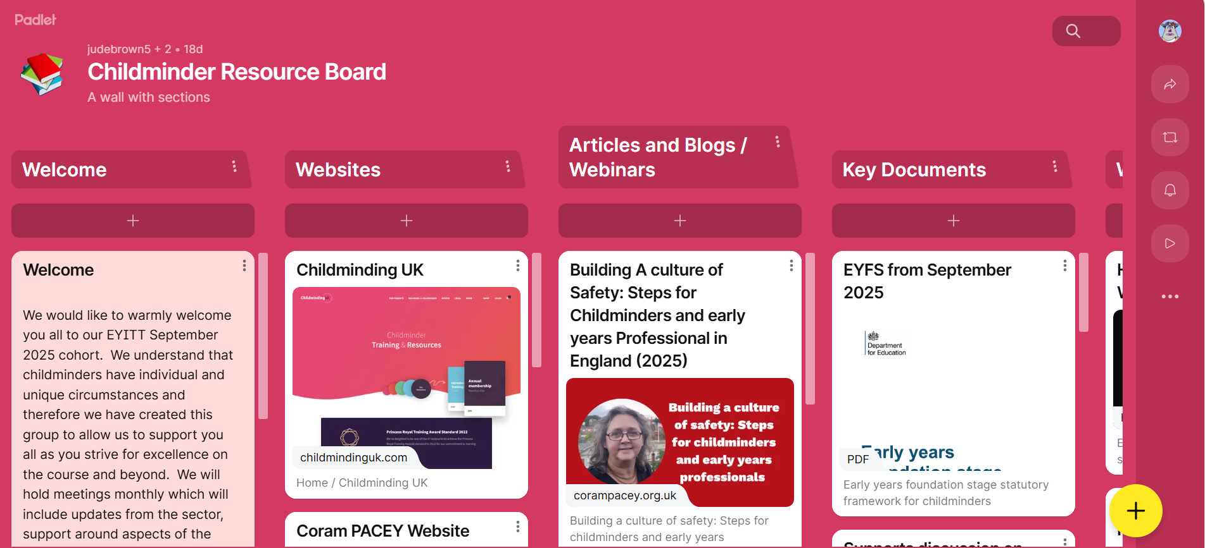
A childminder Padlet of resources.
Notes:
Make links here to online resources to support focused around training days, modules and 7 areas of learning study packs.
We want to celebrate the Early Years context of childminders and share good practice as a group
Give examples, e.g. Leadership Action Plan and how this will look different for childminders, compared to those working in an EY setting or school.

Slide 10

What is the EYITT programme like?
Face to face or virtual sessions for training days
Online platform for uploading work and assessment and accessing modules
A dedicated personal tutor to support you throughout the programme
A setting and placement mentor to support and observe you each week
Individual plan to help you make progress and offer challenge

Slide 11
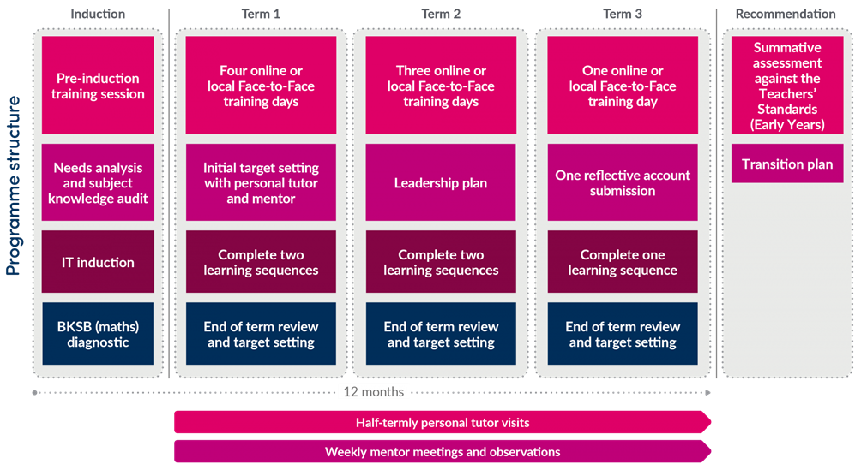
Programme Structure
Notes:
Throughout the programme, trainees will acquire Subject Knowledge, Professionals Skills and learn Professional Behaviours on their journey to becoming Early Years Teachers
Initial phone call with MF to plan out your journey.

Slide 12
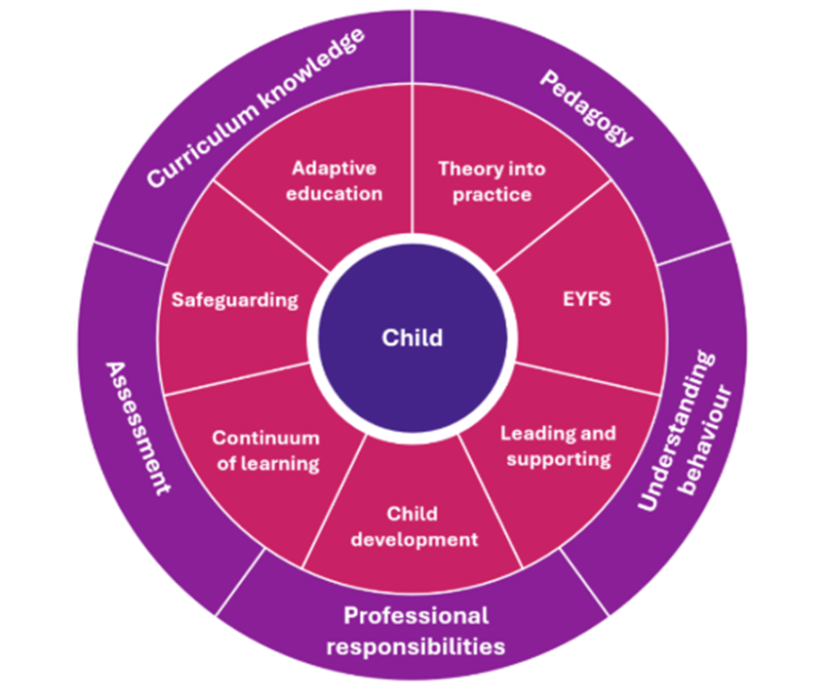
EYITT Curriculum Map
Our curriculum is:
Broad and balanced
Relevant
Forward thinking
Key themes for ITT
Focus on safeguarding, leadership and well-being, will also be threaded through each training day
Notes:
The EYITT curriculum encompasses the totality of trainees’ learning experiences throughout their time on the programme. Our curriculum is broad, balanced, relevant and forward thinking in order to meet the needs of the Early Years sector and raise outcomes for all children. Immersion in the curriculum and the experiences it offers will prepare trainees for their future career as Early Years Teachers.
The EYITT program combines in-person and online learning, practical experiences, and teaching observations. It focuses on enhancing student teachers' understanding of the Early Years Foundation Stage (EYFS) and the National Curriculum, as well as developing their leadership skills. Student teachers are expected to demonstrate their achievement of the Teachers’ Standards (Early Years) through their personal practice.

Slide 13
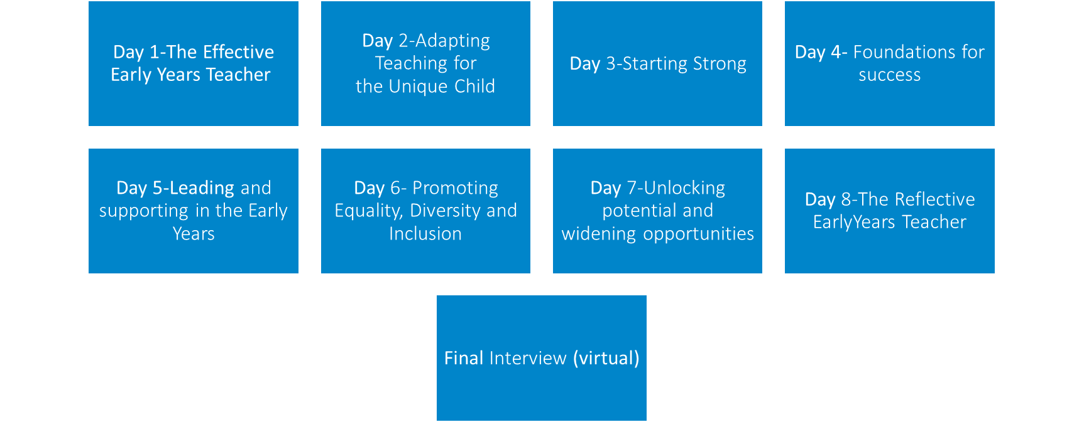
Training Days

Slide 14

The role of the setting/placement mentor
Support can be offered to help you find a suitable mentor.
Mentors are ‘expert colleagues’ who will help you to develop your skills and knowledge as an EY Teacher
Mentors will share their experience, expertise and skills on different aspects on the curriculum
Observe you each week and give detailed feedback
Set SHARP targets to help you progress and master the Early Years Teaching Standards
This Photo by Unknown Author is licensed under CC BY-ND

Slide 15

A typical Day
Time spent directly with children supporting their play and learning
Observation and assessment
Teaching activities that you have planned
Reflection on practice
Discussions with parents and colleagues

Slide 16

A typical week
Observation completed by your mentor
Reading and research
Study time
Uploading documents to Mosaic
Keeping in contact with your tutor and mentor

Slide 17

A typical month
Attend your training day
Complete your monthly reflection
Meet deadlines for teaching and learning sequences
Work towards your targets

Slide 18

A typical term
End of term review and target setting
Complete your placement days/blocks
Visits from your personal tutor
Enhancement sessions

Slide 19
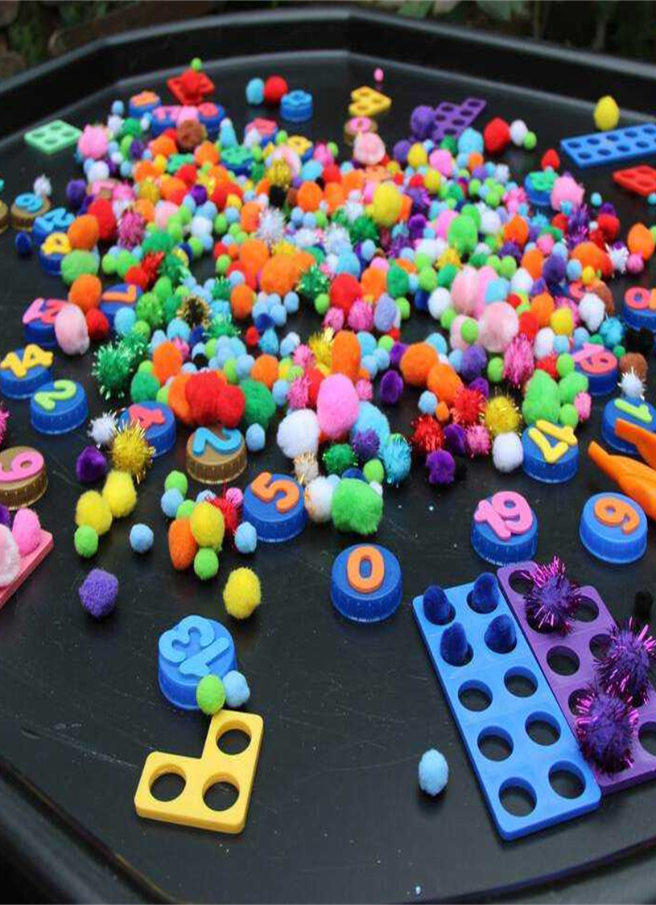
ITT requirements for placement
Every student must cover the age groups from 0-5 years as a minimum (DfE requirement)
Placements will depend on the ages of children that you have on roll.
All students must complete a placement of at least 25 days.
Placements need to offer a variety and depth of experience to enable student teachers to meet all of the Early Years Teaching Standards
Placements are completed in at least 2 different settings (Rated good or Outstanding with Ofsted) Your childminding setting is setting number one! Some students may need 3 settings.
Placements must be in a setting which delivers the EYFS or works to National Curriculum expectations

Slide 20

How is Early Years Teacher Status assessed?
Ongoing assessment which includes observations, a reflective account, sequences of work and termly targets
Demonstration of mastery of the EYITT curriculum
A summative judgement that each student teacher meets the Teachers’ Standards (Early Years)
Exam board and recommendation for the award of Early Years Teacher Status

Slide 21

What are the entry criteria?
A degree (or equivalent Level 6)
GCSE in English, Maths and Science at grade C/ grade 4 or above…. or a recognised equivalent
The right to study and work in the UK
Competence in spoken and written English
A satisfactory DBS check
For all students: meeting the health and physical capacity to teach requirements

Slide 22

Equivalency Tests
GCSE Qualifications and equivalency tests
If applicants do not hold GCSEs in maths, English or science (no grade C/4 or above), they can complete equivalency tests.
*GCSE science equivalency test can be either Biology or combined.
We will accept equivalency tests from:
https://astarequivalency.co.uk/
Or any other equivalency provider!

Slide 23

Maths for free!
If applicants require their maths equivalency test, they can complete this through BPN:
BKSB platform
This will enable them to meet the ITT requirements to access our programmes
*May not be valid with another provider

Slide 24

What childminders on EYITT are saying about us!
I hugely appreciate your help and support. I can already feel your positive input into my own sense of wellbeing and self-esteem; I am loving this course! Thank you for everything you are doing in guiding me through everything.
My experience of the course so far and training days has been amazing. The Padlets are also fantastic!!

Slide 25
What childminders on EYITT are saying about us!
Over the moon with the Padlets and all your help. It is a privilege to complete this course, and I have chosen BPN because I feel supported and encouraged!
It's a bit like having my very own Fairy Godmother- my motivation has no bounds!

Slide 26



We can help you take the next step!
Have a look on our website:
www.bestpracticenet.co.uk/eyitt
Check out our new childminder website page!
Talk to our team
EYITT@bestpracticenet.co.uk
@bestpracticenet
facebook.com/bestpracticenetwork/

Slide 27

EY SEN programme

Slide 28
Any questions

